Slide 1
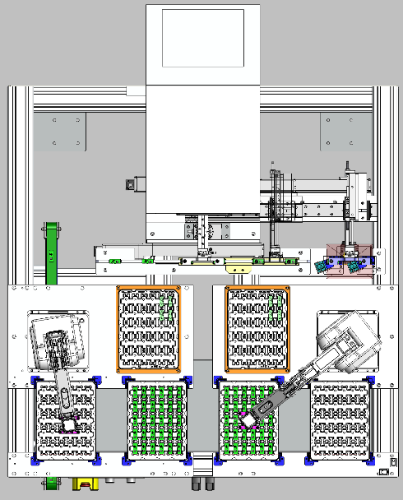
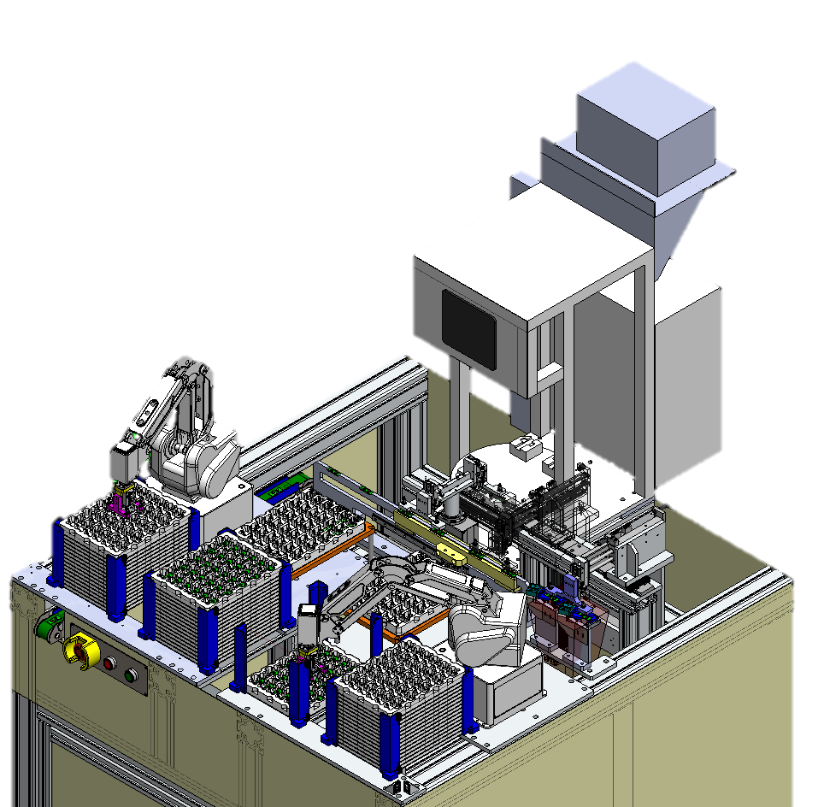
Project Sharing
2. STM-Model’s FCT Automation Pick & Place
Test
NG
OK
Positioning
& 2DID
Empty Tray
Empty Tray
AT FCT Tray
BF FCT Tray
Tray transfer
WIP transfer
Output
Input
Mechanism movement

